Slide 1
Eda project - Northwind

Slide 2
Northwind
Northwind database is fictitious company called “Northwind Traders,” which imports and exports specialty foods from around the world. The Northwind database is an excellent tutorial schema for a small-business ERP, with customers, orders, inventory, purchasing, suppliers, shipping, employees, and single-entry accounting.

Slide 3
Questions
What are the most requested cities from Northwind for year'2012'?
How much is the total orders per year ‘2012’?

Slide 4
Project idea
We will open a NorthWinds convenience store, and we will be looking for cities with high income, high order numbers, and most profitable cities during 2012.

Slide 5
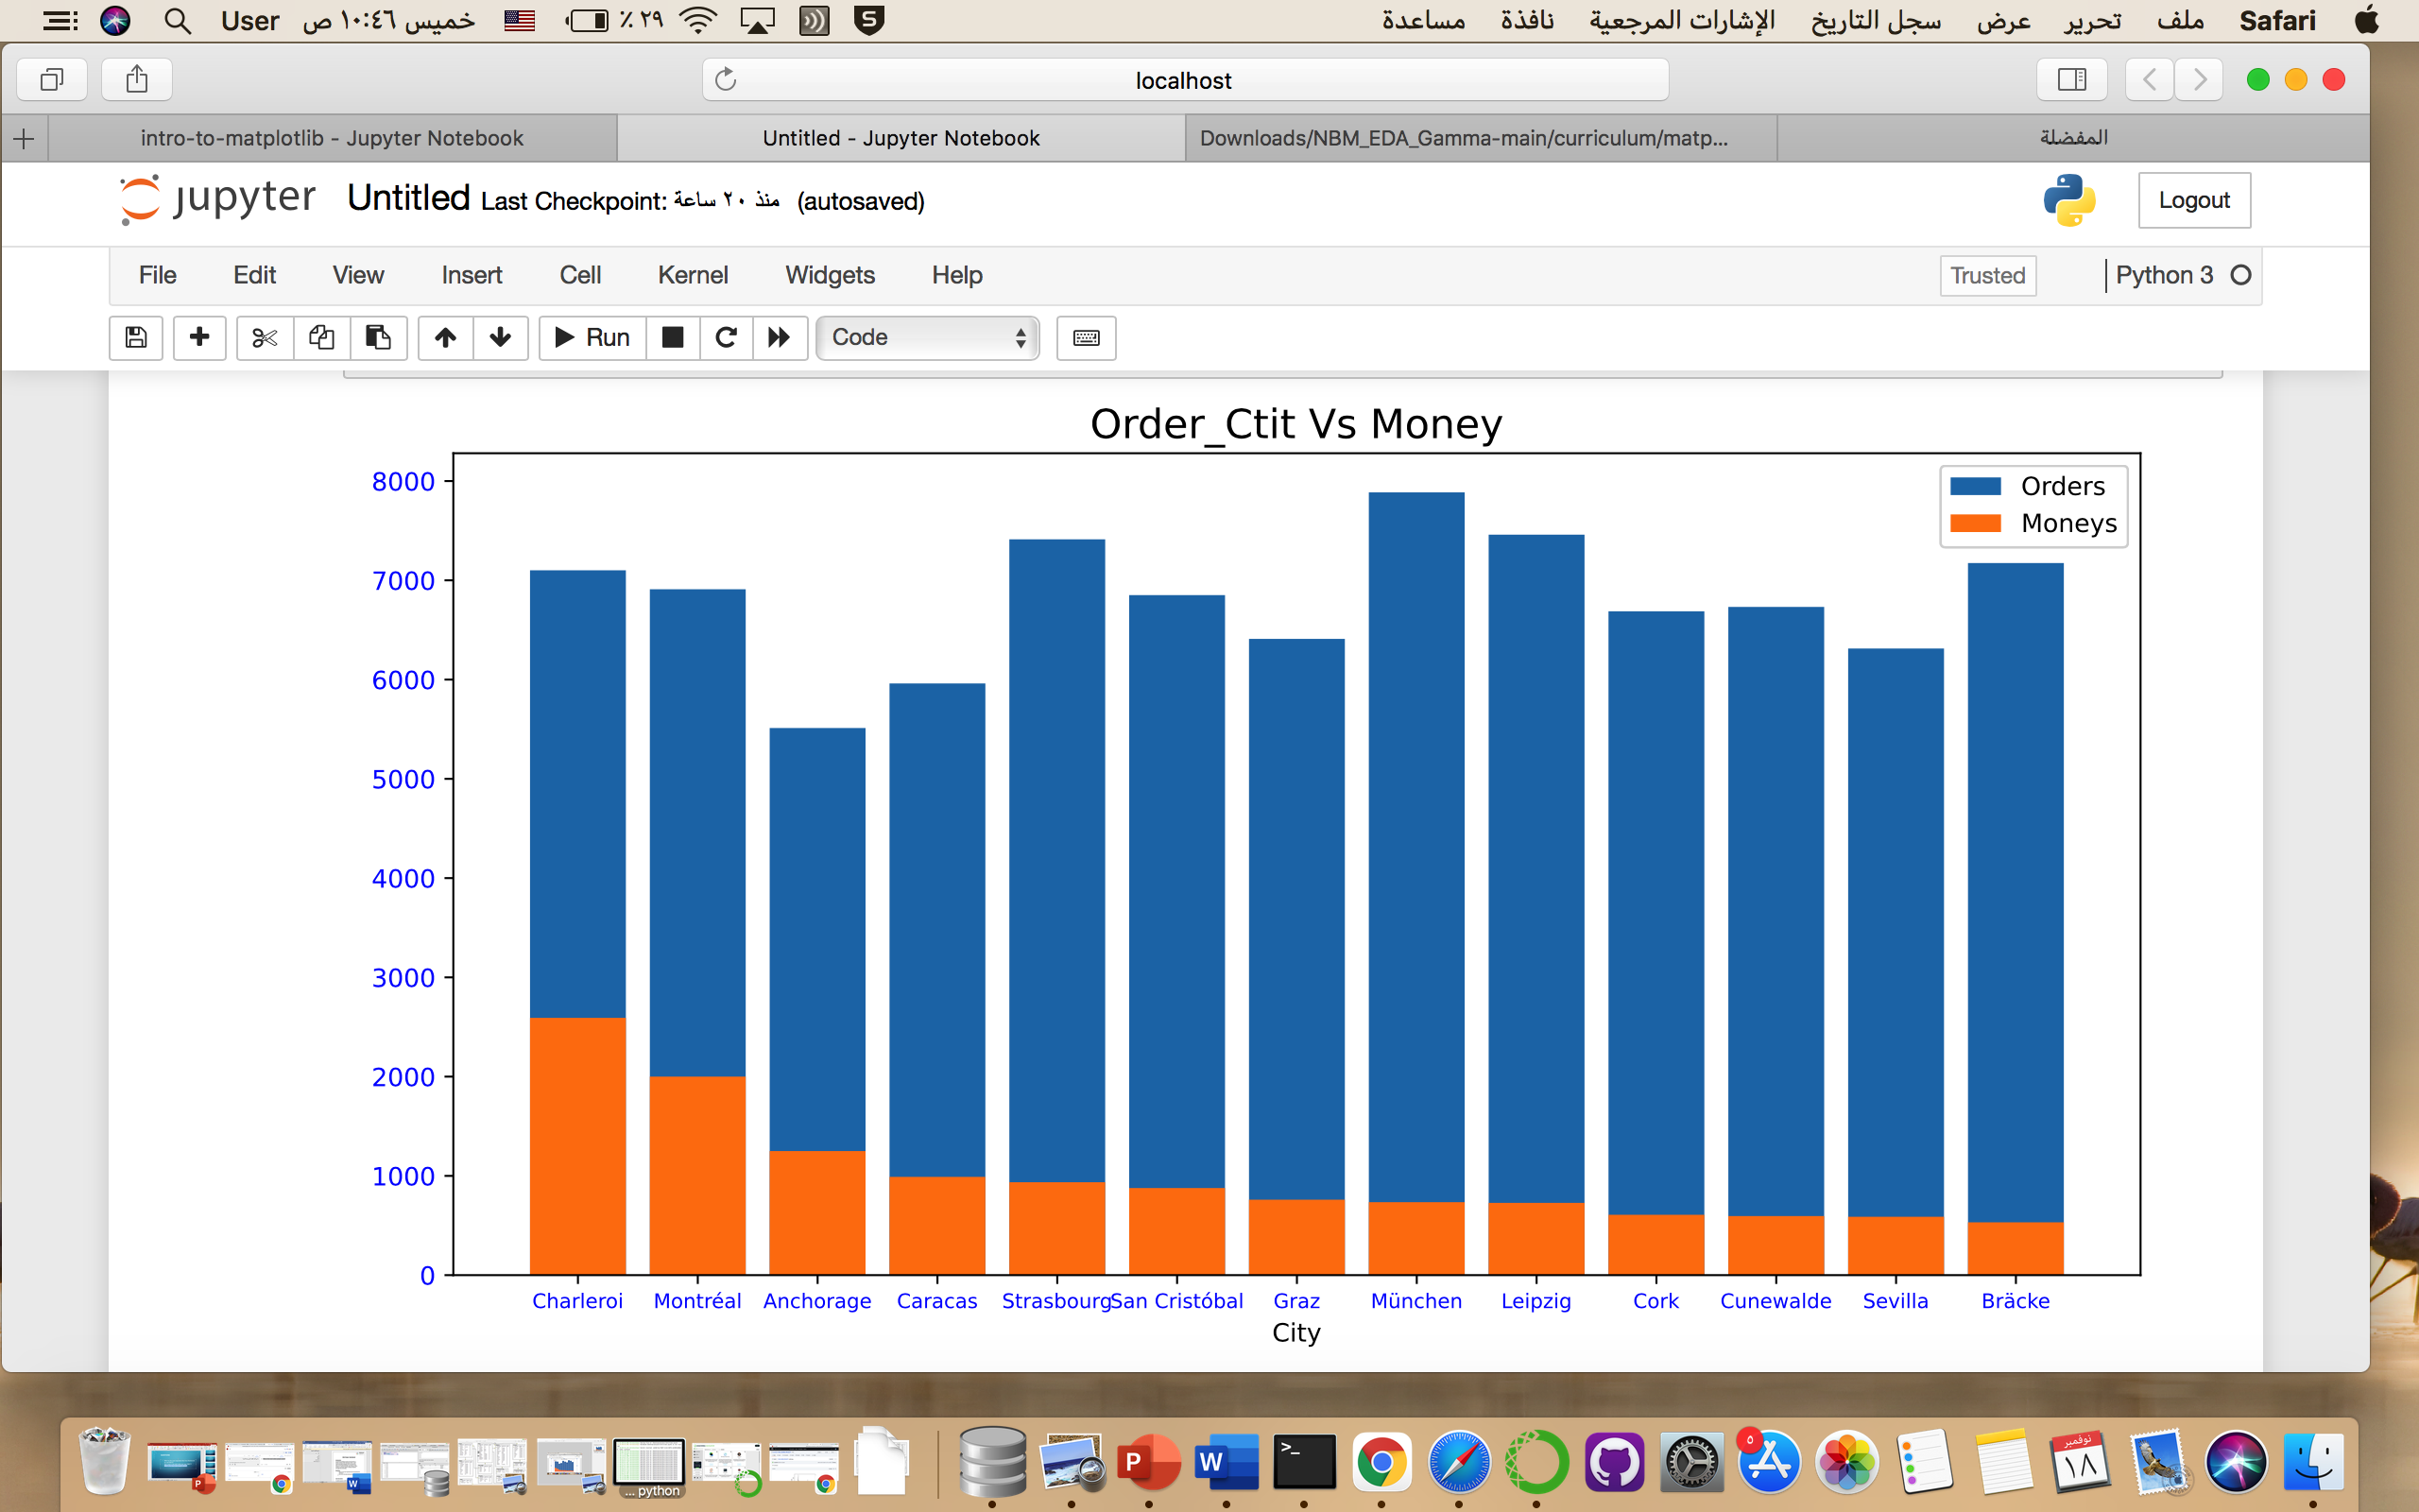
Data Visualization

Slide 6
result :
Opening of the shop in the city of Charleroi, cities with high income and average demand.
Other cities such as München and Bracke have the highest orders , but their income is
small and it is possible to increase declarations for products.

Slide 7
Thanks for listening

